Slide 1
Linear regression with Python
https://pub.towardsai.net/calculating-simple-linear-regression-and-linear-best-fit-an-in-depth-tutorial-with-math-and-python-804a0cb23660

Slide 2
Python File Handling
Python allows users to handle files by supporting read and write files, along with many other file handling options. More details can be learned here
Python is an easy-to-learn, easy-to-debug, widely used, object-oriented and open-source language. Python has been built with extraordinary libraries for data science that are used by programmers every day in solving problems. The top 10 Python libraries for data science include:
NumPy
Pandas
SciPy
TensorFlow
Matplotlib
Keras
SciKit-Learn
PyTorch
Scrapy
BeautifulSoup

Slide 3
Pandas
The Pandas library is one of the most preferred tools for data scientists to do data manipulation and analysis.
Features:
Enables you to create your own function and run it across a series of data
Contains high-level data structures and manipulation tools
Pandas Installation
Installation via Terminal
pip install pandas or conda install pandas.
Installation in Anaconda
Pandas or any other packages can be installed in Anaconda environment by following the tutorial here.
Import Convention
>>> import pandas as pd
Find more details about Pandas here.

Slide 4
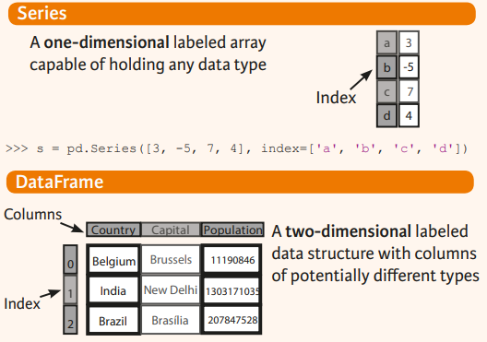
Dataframe
Pandas DataFrame is a way to store data in rectangular grids that can easily be overviewed.
tabular data structure with labeled axes (rows and columns).
Format: pd.Dataframe(data, index, column)
Data should be at least two-dimensional, index will be the row name and column values for the columns.

Slide 5
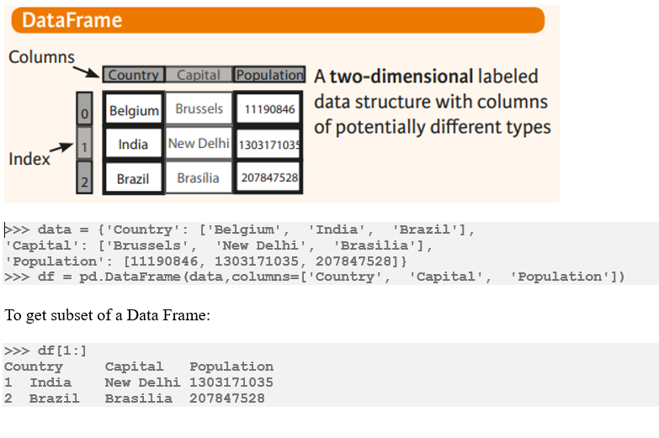

Slide 6
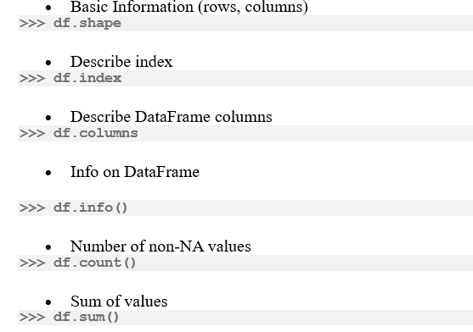
Dataframe(cont.)
Retrieving DataFrame Information

Slide 7
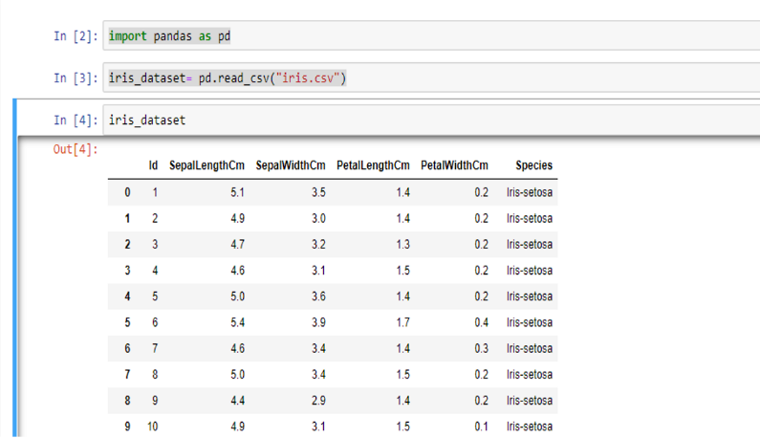
For more information about file handling using Pandas, visit this site.

Slide 8
Matplotlib
Matplotlib is a low-level graph plotting library in python that serves as a visualization utility.
Most of the Matplotlib utilities lies under the pyplot submodule.
>>> import matplotlib.pyplot as plt
plot()
used to draw points (markers) in a diagram.
By default, it draws a line from point to point.
The function takes parameters for specifying points in the diagram.
Parameter 1 is an array containing the points on the x-axis.
Parameter 2 is an array containing the points on the y-axis.

Slide 9
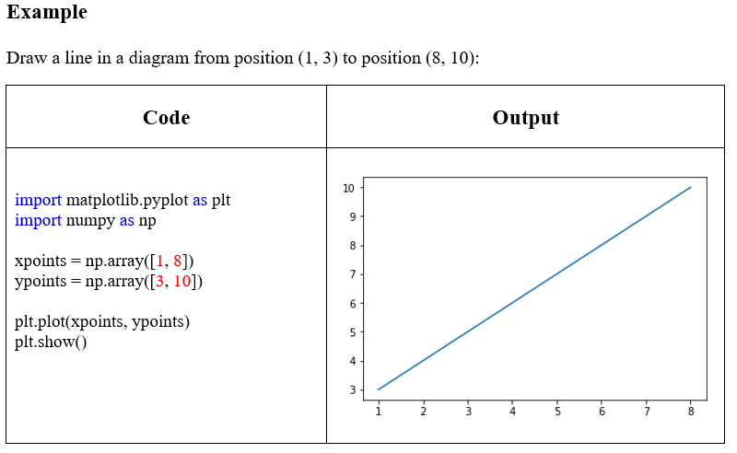
There are many types of single lines/multiple lines that can be drawn, explore other types at: https://www.w3schools.com/python/matplotlib_line.asp

Slide 10
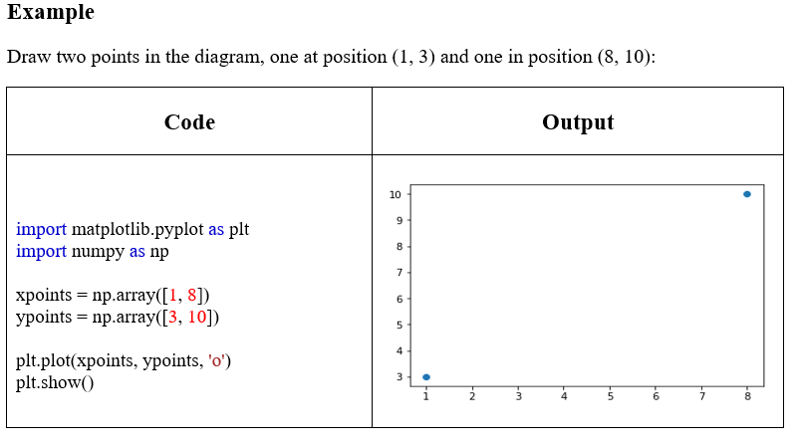
There can be different type of markers, you can explore at: https://www.w3schools.com/python/matplotlib_markers.asp

Slide 11
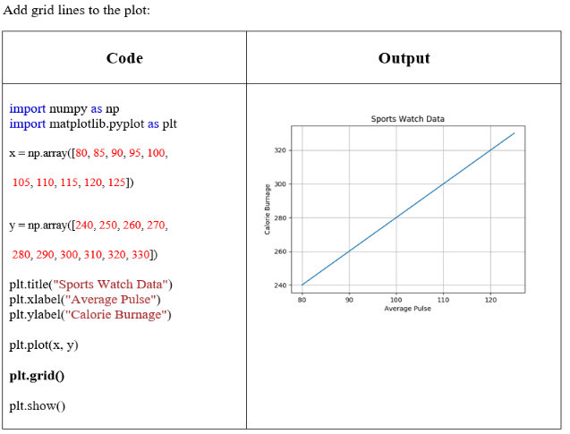
Different type of grid can be generated, for more details see: https://www.w3schools.com/python/matplotlib_grid.asp

Slide 12
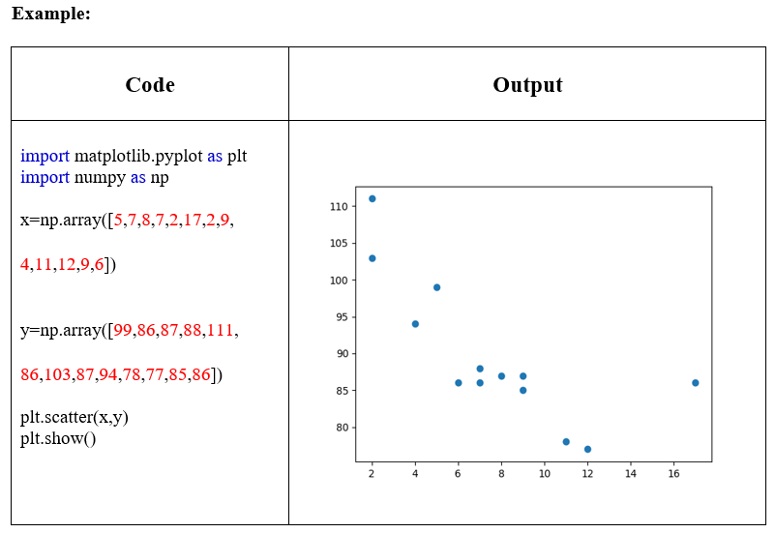
There are different type of scatter graphs that can be created (kindly see the link given, as all examples will make the manual lengthy): https://www.w3schools.com/python/matplotlib_scatter.asp

Slide 13
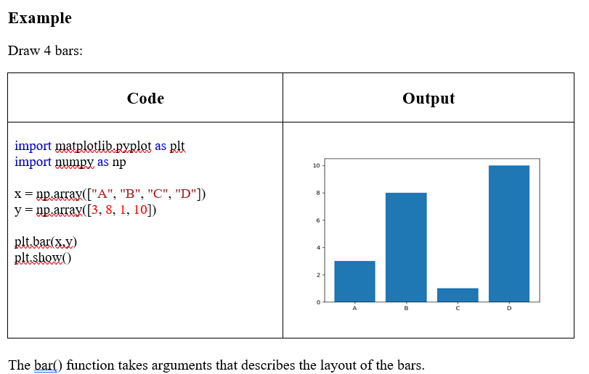

Slide 14
Simple Linear Regression from Scratch Implementation

Slide 15

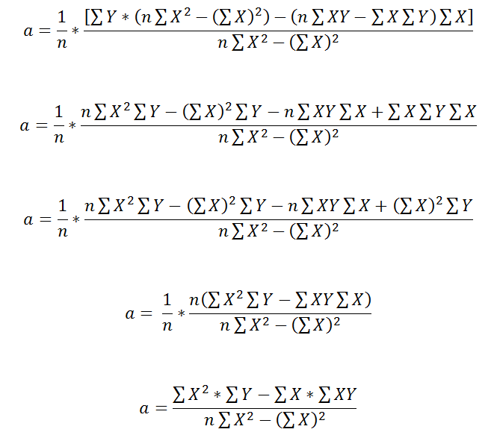
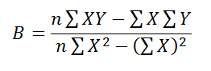
Linear Regression
Recalling last lecture for linear regression our goal was to find the best fit line.
Best Fit line:
Therefore, we need to calculate optimal parameters i.e. Slope(B) and Intercept(a).

Slide 16
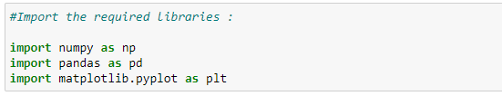
Import Data
The first step is to import/load our dataset in a python file.
To use pandas library, we have to first import it.

Slide 17
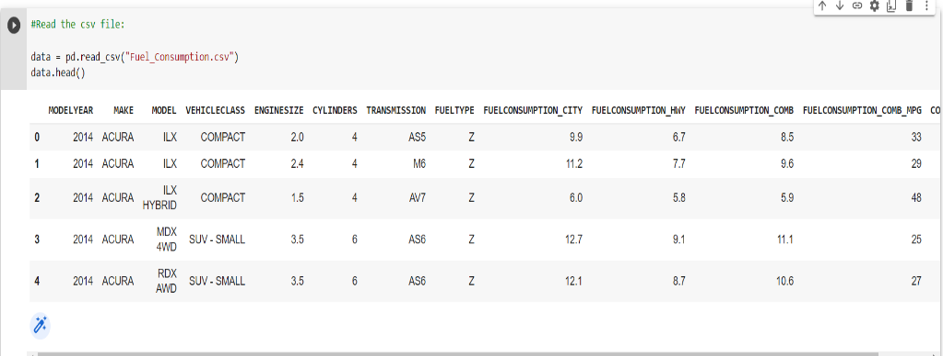
Read the data into the data frame object.

Slide 18
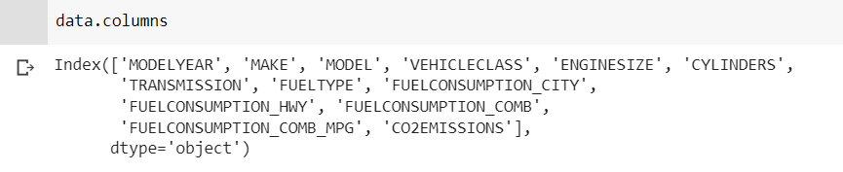
To see the total columns of the dataset.

Slide 19
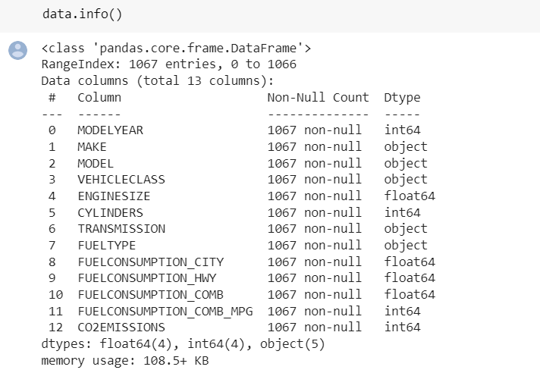
Data Preprocessing
Before fitting the model, we have to check the dataset if any entry is null or not.
If any value is null, we should remove all those null entries.

Slide 20
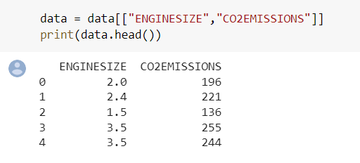
Feature Selection
Select columns to build our model.
Select only those features from our dataset that we are going to use for predictions:

Slide 21
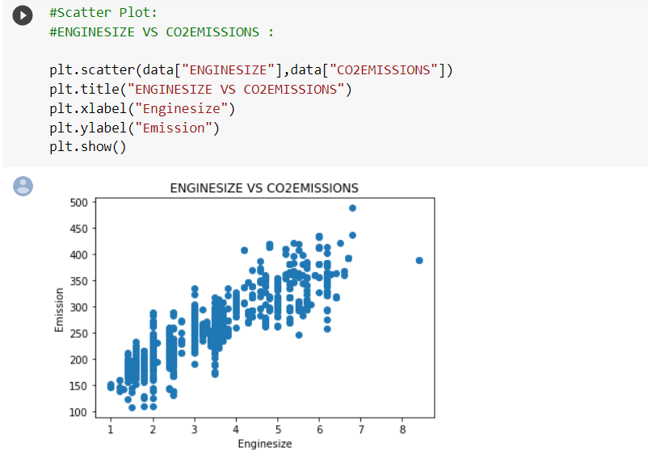
Scatter Plots
Plot the data on the scatterplot:

Slide 22
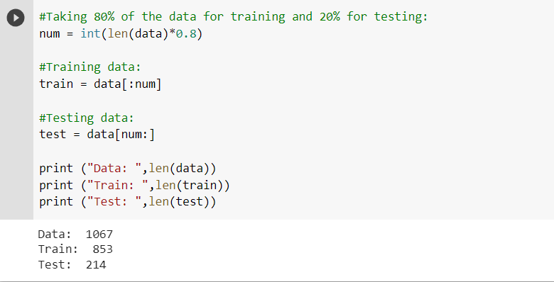
Test and Training Dataset
Divide the data into training and testing dataset.

Slide 23
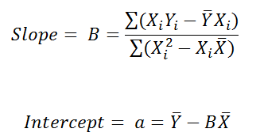
Calculating Parameters
For finding the best fit we will first calculate the slope and intercept.
The formulas used in the following code are:

Slide 24
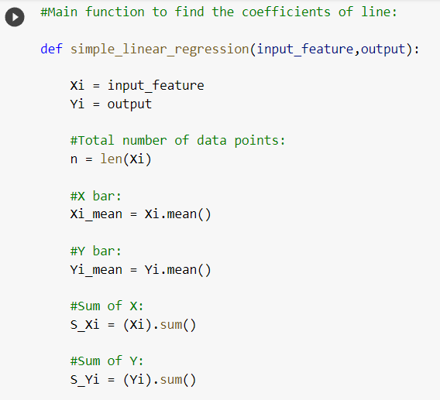
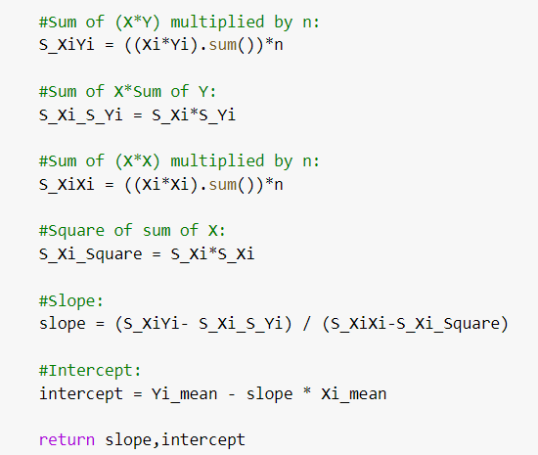
Main Function for slope and Intercept:

Slide 25
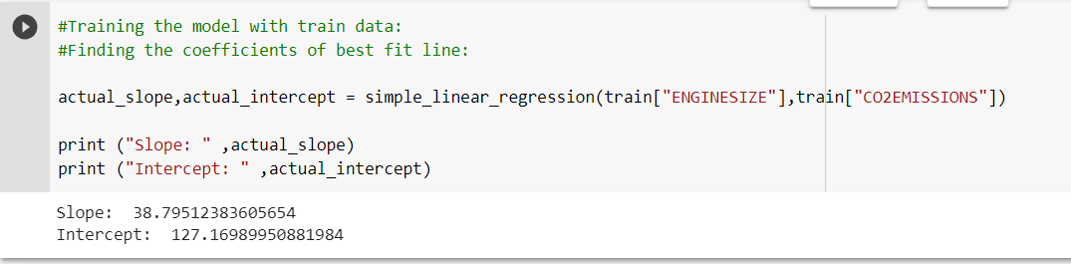
Training Model
Use the function coded in pervious slide for finding the co-efficients of our actual dataset.

Slide 26
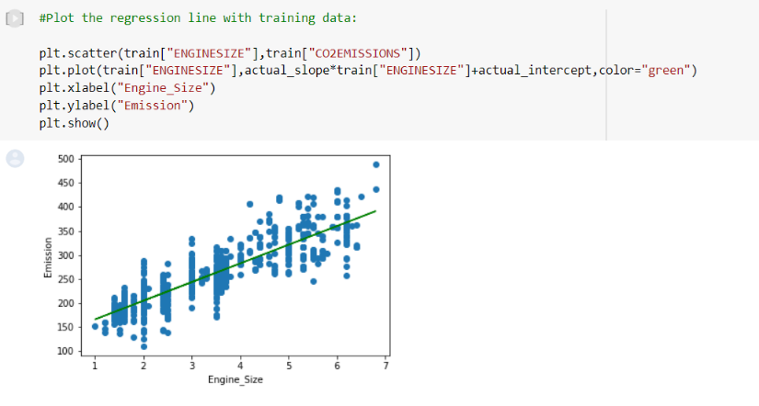
Plotting Best fit line
Plot the regression line with actual data.

Slide 27
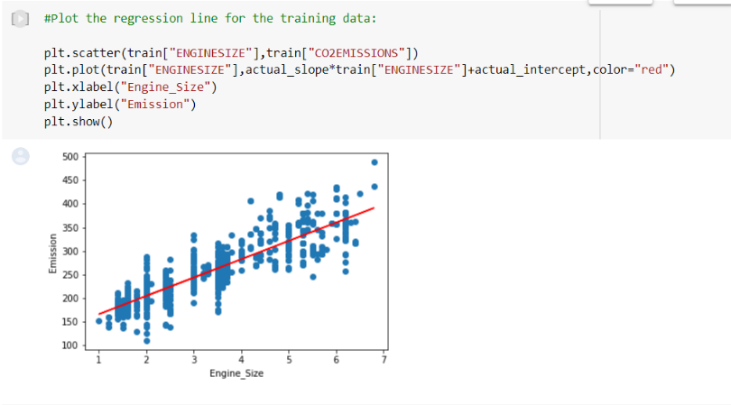
Plotting model on Training data
Plotting the training data with the regression line.

Slide 28
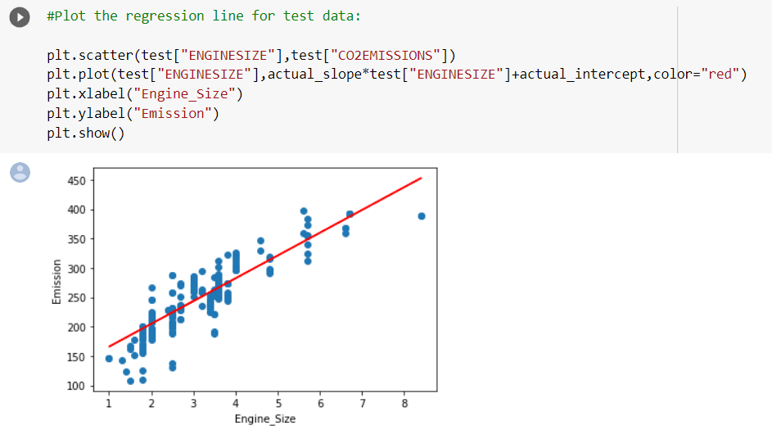
Fitting model on Test data
Plotting the test data with the regression line.

Slide 29
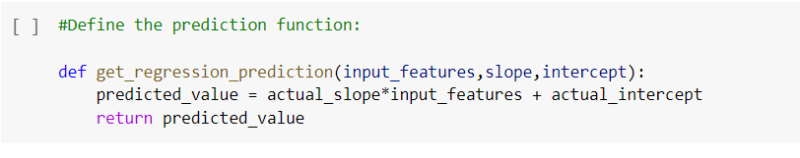
Prediction Function
Define the prediction function:

Slide 30
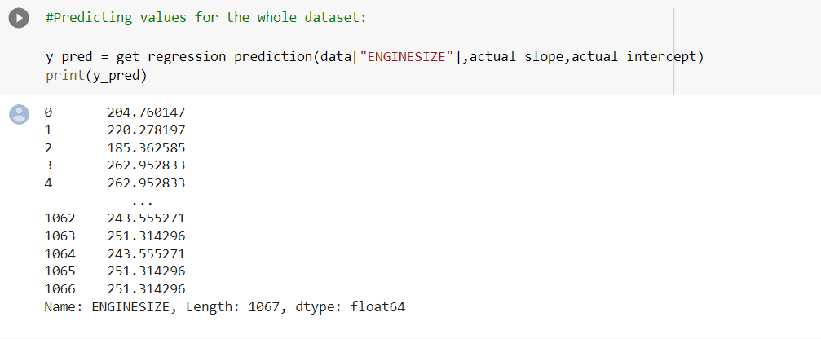
Predicting for Complete Dataset
Predicting values for the whole dataset:

Slide 31
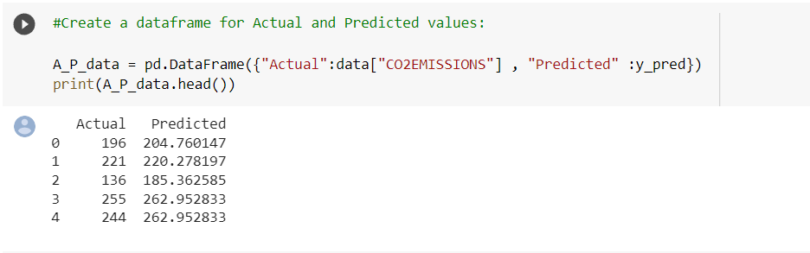
Actual vs. Predicted Values
Create a data frame for actual and predicted values:

Slide 32
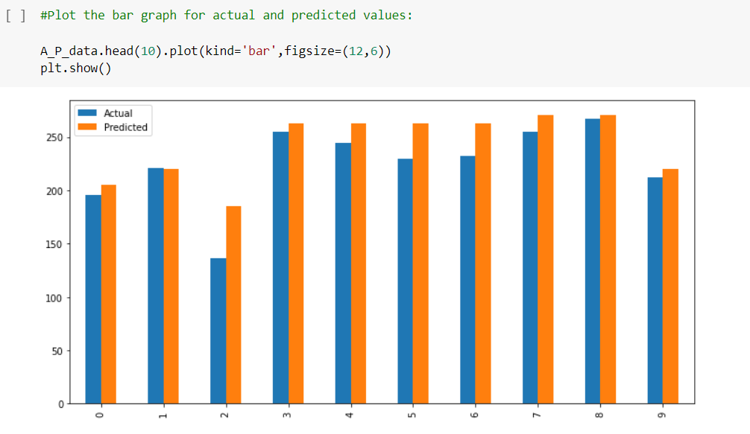
Actual vs. Predicted Values
Create a data frame for actual and predicted values:

Slide 33
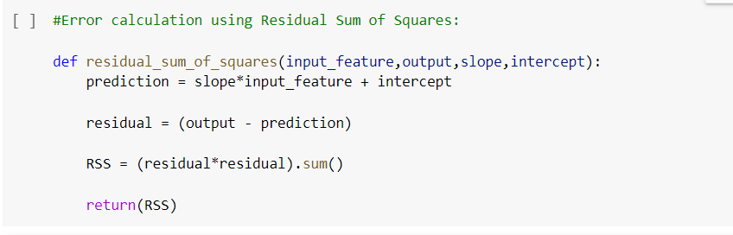
Error- Residual Sum of Squares
In ML, error is used to see how accurately our model can predict on data it uses to learn; as well as new, unseen data. Based on our error, we choose the machine learning model which performs best for a particular dataset.

Slide 34
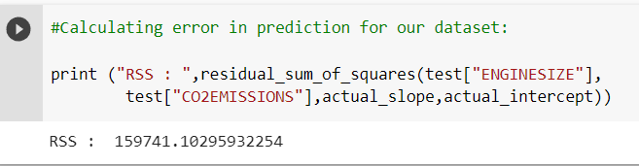
Error- Residual Sum of Squares
Calculating error:

